Slide 1
Elements
PrintNet T

Slide 2
Context Schema
Workflow
Data Input
&
Manipulation
Document
Design
(Layout)
Impositioning
Approval (Proof)
Spool Production
Notes:
Elements are created and formatted in PrintNet T Layout.

Slide 3

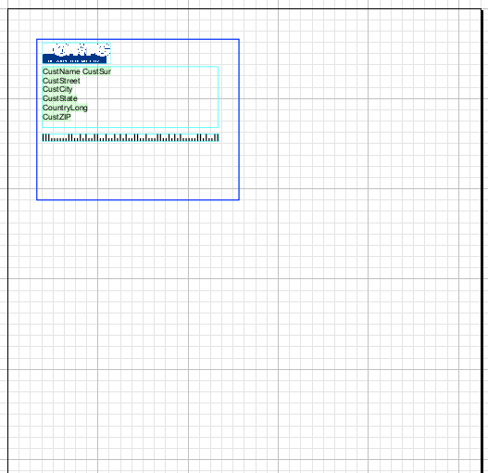

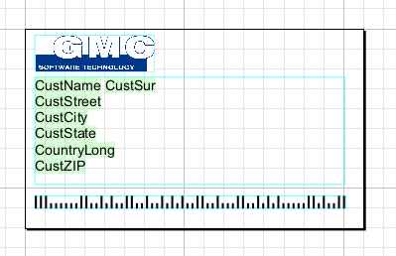
Elements – Introduction
Imagine:
  You have several objects (flow area, image, and barcode),
  You want to group these objects together, and…
  You want this group of several objects to act like one object.
  This is possible with Elements.
Element view (Layout)
Page view (Layout)
Proof view
Notes:
Note to trainer: highlight the difference between Element view and Page view. The blue box in each screenshot shows what you are able to select in each view (i.e., individual objects in Element view, and the whole element in Page view)
Element View: possible to move and alter individual objects (e.g., change or move the image, change or move Text Style of text flow, change or move barcode type, etc.).
Page view: not possible to move and alter individual objects in an element; only the element itself can be moved (thus moving all grouped objects in the element with it.

Slide 4

Elements – Purpose
  Objects cannot be placed into flows directly.
  Elements act as envelopes for objects.
  Elements:
  Can be placed within flows
  Can move with variable text in a flow
  Can group objects together for collective conditional flow selection
  Are more than simply grouping objects together!
Notes:
Elements act as envelopes for objects, so that they may be placed into flows.
Unlike other objects (barcodes, images, etc.), elements can be placed directly into a flow. (If you try to place a barcode or image or another object directly into a flow, it will automatically become an Element).
If text in a flow area is variable, it may move up or down a few lines depending on how long or short it is. If an element is to be part of this variable flow (e.g., you want a signature image to appear directly underneath a variable letter body), you can use it as part of the text flow, and then your element will move variably with your text.
If you want more than one object grouped together to be conditionally selected together, you can do this with elements. For example, imagine a situation where, depending on a customer code within the data structure, each record will have a different logo and company name at the top of the page. With elements, you can create all of your logo and company name possibilities on different elements, and then assign each element to a particular customer code. Each record will variably select the logo/company name element according to the proper customer code, so that all the customers who have customer code 1 will get element A, and all customers who have customer code 2 will get element B, and so on.
Elements serve a larger purpose than simply grouping objects together for easier layout organization. Grouping and Arrangements have a separate presentation.

Slide 5

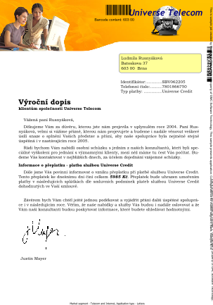

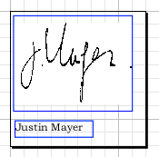
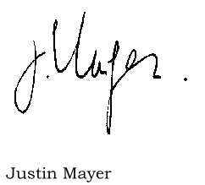
Elements – Example
An element is inserted into variable text flow.
Record 1 with variable text (short letter)
Element created in Layout, and inserted into letter flow
Record 2 with variable text (long letter)
Notes:
You can see that, if the Element is inserted directly into the letter flow after the variable text, it will directly follow the body of the letter no matter how long or short the letter is.

Slide 6
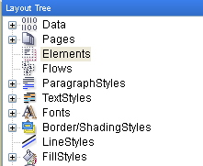
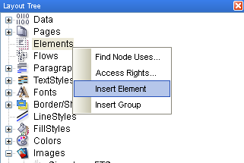
Creating Elements
Right-click

Slide 7
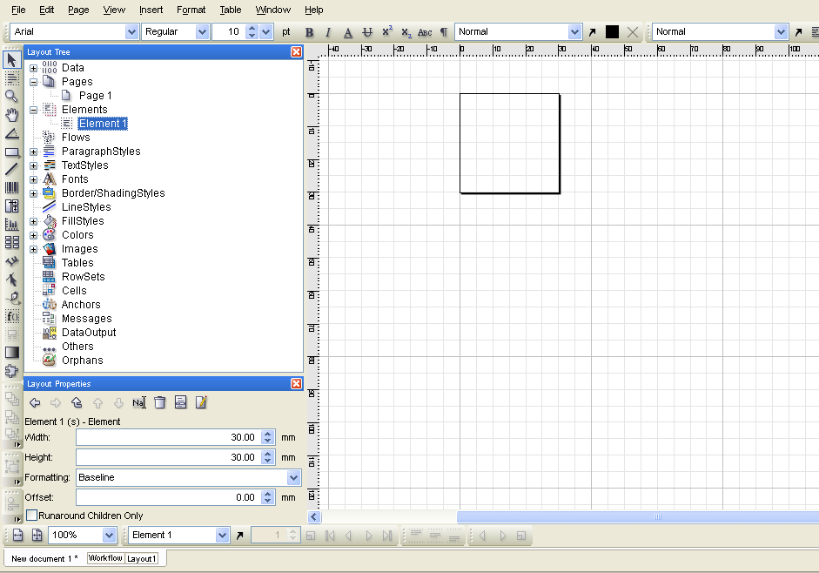
Elements
Double-click on an Element in the Layout tree to open the Element view in Layout.
Notes:
Notice that the Element itself appears in the Layout as a small page.

Slide 8
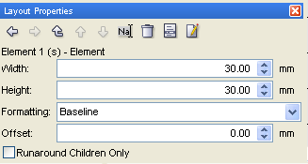
Elements – Layout Properties
No tabs in Element Layout Properties.
Specify the size of your element
Notes:
Formatting and Offset are extra specifications that allow you to modify the relationship between an element and any text that you include it with in a flow area.

Slide 9
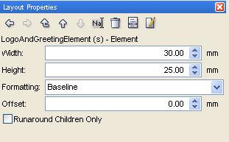
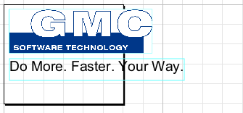
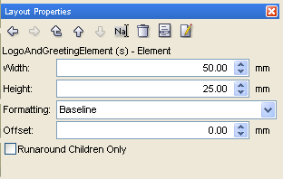
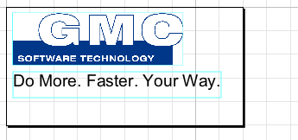
Element Size – Example
Notes:
Notice that the objects inserted into the Element will maintain their size no matter how big the Element itself is. The Element size must be modified to ensure that all objects can fit within it. If an object leaks off the side of the Element, then in any flow areas that contain that Element, the objects within the Element have the possibility of overlapping with any other flow in the flow area. You will still be able to see the entire content of objects in the Element, even if they bleed off the edge. The point of an Element is to establish a locative relationship between itself and other flow that it appears in a flow area with.

Slide 10
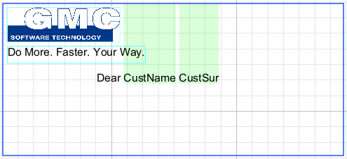
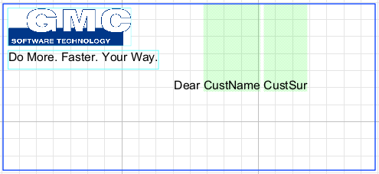
Element Size – Example
Notes:
Notice that the objects inserted into the Element will maintain their size no matter how big the Element itself is. The Element size must be modified to ensure that all objects can fit within it. If an object leaks off the side of the Element, then in any flow areas that contain that Element, the objects within the Element have the possibility of overlapping with any other flow in the flow area. You will still be able to see the entire content of objects in the Element, even if they bleed off the edge. The point of an Element is to establish a locative relationship between itself and other flow that it appears in a flow area with.

Slide 11
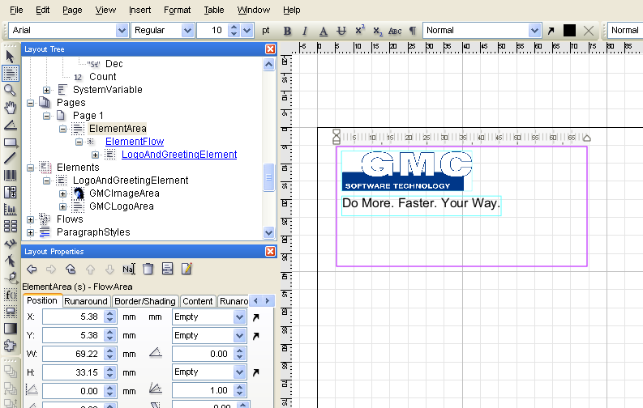
Inserting Elements into Flow
To insert an Element into a flow, drag and drop it from the Layout tree into a flow area.
Notes:
To insert a previously created Element into a flow area, simply drag and drop it from the Layout tree. The flow area must be created already; it is also possible to insert an Element directly into the Layout (and not into a flow area) but then the Element will not have any relationship with any of the flow areas on the page. You must include an Element in a flow area if you want it to be affected and/or affect some other flow in that flow area.
You MUST insert an Element into a flow area from the Layout tree; it cannot be done by dragging and dropping an Element that is already on the Layout page – this will place an Element overtop of the flow area, but not inside it.

Slide 12
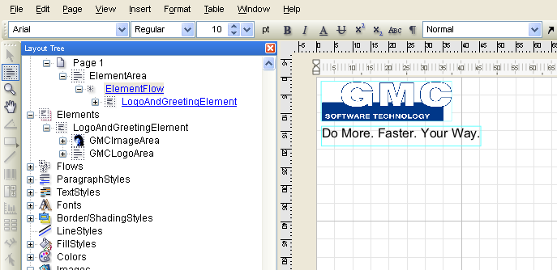
Inserting Elements into Flow
You can also double-click on a flow in the Layout tree to insert an Element directly into the flow
Notes:
A better way to work with Elements and flows is to double-click on a flow to open the flow view, and drag and drop the Element there. This is the most optimum way of working with flows, because then there can be no mistake about where an Element is being placed. Also, it allows for a more close-up view of the flow itself.

Slide 13
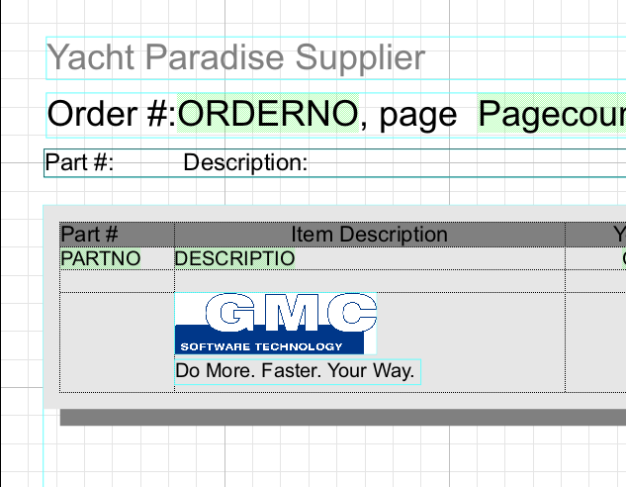
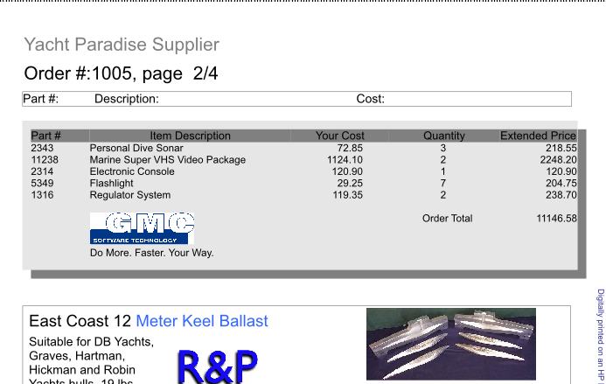
Elements in Tables
  Elements can also be used in table cells.
  Only way to use an object or group of objects in a table.
In Layout
In Proof
Notes:
Tables will be explained in later presentations.

Slide 14

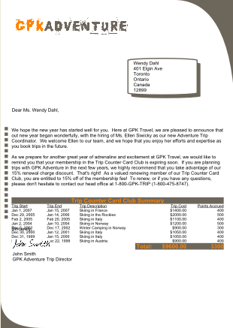
Elements – Tutorial
Change the layout of a letter so that the salutation and signature are included in the body.
  Open ElementsExercise.wfd.
  Proof the job <F6> and scroll through the records
  In records 2 and 6, the signature overlaps with the variable table.
Oops! Overlap!

Slide 15
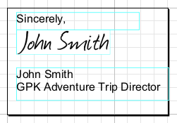
Elements – Tutorial
Change the layout of a letter so that the salutation and signature are included in the body.
  Create a new Element; double-click to open the Element view
  Design an Element that has all the objects of the salutation: “Sincerely,” the signature image, and the employee name (you can drag and drop from the Layout tree here – don’t forget to create your new flow areas on the Element first).

Slide 16
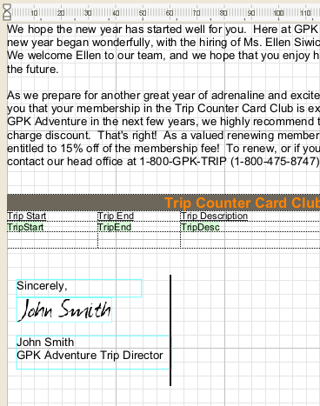

Elements – Tutorial
Change the layout of a letter so that the salutation and signature are included in the body.
  Delete the former salutation from your Layout page
  Put your new Element directly in the LetterBodyFlow, after the Trip Summary Table.
Double-click on LetterBodyFlow to work directly with the flow.

Slide 17

Elements – Tutorial
Change the layout of a letter so that the salutation and signature are included in the body.
  Proof your job <F6> and scroll through the records
  Notice now that the Element actually moves with the variable flow.
You may have vertical overflow; resize your flow area if necessary.
Notes:
Open ElementsExercise_done.wfd if you need help with the resolution.

Slide 18

Elements – Summary
In this presentation we have learned:
  How to create and use Elements
  About an Element’s positional relationship with flow
  Why elements are important objects to be included with variable flows.

Slide 19

Elements – Discussion
When do you need to use Elements inside your flow?
How do you create an Element?
Can you think of any reason not to use Elements? Why?
Notes:
When do you need to use Elements inside your flow?
When your flow contains variables and/or variable text. You use Elements in this case because your Element will actually move WITH the text – it has a positional relationship to the text itself. If you don’t use Elements, then the positional relationship is to the page, and some of your content will remain fixed, even though your variables and/or variable text will change. We saw the importance of using Elements in the exercise, where without the Element our text overlapped.
2. How do you create an Element?
The best way is to create the Element first, then insert your objects to the Element. Right-click on “Elements” in the Layout tree and select “Insert Element”. Another way to create Elements is to first group your objects together on the Layout area, and from the Layout tree insert your new Grouped Object into a flow – the Element will be created automatically.
3. Can you think of any reason when not to use Elements? Why?
Do not use Elements if you are working with fixed text. Elements can slow down production, so should only be used when necessary (i.e., when there is variable text).

Slide 20

Thank You.
Do You Have Any Questions?

